Slide 1
DengAI
PREDICTING DISEASE SPREAD
140284J - P.K.K.D. Kankanamge
140562K - T.W.C. Sandeepa
140334N - H.A.D. Lakmal
140204R - H.L.M. Hansini
140700J - Y.R. Witharanage

Slide 2
Introduction
• A data science competition where competitors have to predict local epidemics of dengue fever
• Dengue’s relationship to climate is complex
• Predict the number of dengue fever cases reported each week in San Juan, Puerto Rico and Iquitos, Perú based on environmental variables describing changes in temperature, precipitation, vegetation etc.

Slide 3
Methodology
Data preprocessing
Identify features having null values in both Train and Test dataset
Feature Selection
Prediction
Support vector regression, XGBoost, Gradient Boosting, Random Forest models were used for prediction
Random Forest Regressor and Gradient Boosting Regressor were used to develop ensemble model
All models were evaluated with 5 fold cross validation

Slide 4
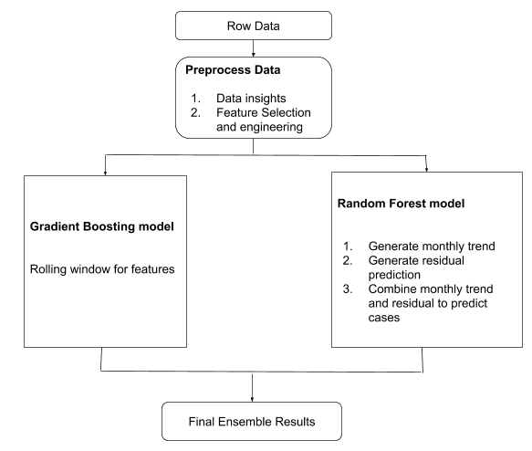
Methodology - Final Model.
Two models were built to predict for two cities.
Weighted the results from to models
Gradient boosting model: Residual Prediction model = 2:1

Slide 5
Results
Model | Methodology | MAE
 |  | San Juan | Iquitos | Competition
Benchmark Model | Negative Binomial Model |  |  | 25.8173
Model 1 | Linear Regression | 28.2129 | 6.5474
Model 2 | SVR | 23.6062 | 5.7850
Model 3 | XGBoost | 21.7254 | 5.7385
Model 4 | Gradient Boosting | 20.7102 | 5.7156
Model 5 | Random Forest | 19.2954 | 5.7850
Model 6 | Random Forest Regression - Time Series Prediction with rolling window of 52 |  |  | 21.3005
Model 7 | Gradient Boosting with rolling window of 100 and 30 |  |  | 20.3462
Final Model | Ensemble model of Model 6 and Model 7 |  |  | 19.1899

Slide 6
Conclusion
Multiple models were tested to find out the lowest MAE
Developed Random Forest Regressor model to predict the Dengue cases based on the monthly trend and residual prediction
Gradient Boosting Regressor model was developed with smoothen feature data
Prediction system should be advanced and deep enough to tackle all the complex correlation
To address this complexity, an ensemble model was developed by combining Random Forest and Gradient Boosting Regressor models, which outperforms any single prediction model

Slide 7
THANK YOU !

